Slide 2

Learning objectives
In this lesson you will learn to:
  apply logical left and right shifts to binary integers
  use logical binary shifts to multiply and divide unsigned binary integers by powers of 2
  explain why a number may be less precise after a binary shift right has been applied.
For more information about this topic and additional student activities see Topic 2 of the student book
© Pearson Education Ltd 2020. Copying permitted for purchasing institution only.
Notes:
Specification content: 2.1.2 2.1.3 2.1.4 2.2.4

Slide 3
Binary arithmetic
You’ve learned how to add in binary, but what about other operations?
Multiplication and division can be achieved using shifting.
There are two forms of shifting:
logical and
arithmetic.
© Pearson Education Ltd 2020. Copying permitted for purchasing institution only.

Slide 4
Starter
Consider the denary number 760
  What happens if we move the numbers to
  the right?
Now consider the binary number 010
  What happens if we move the numbers to
  the right?
  How about if we move the numbers to
  the left?
7 | 6 | 0
0 | 7 | 6
0 | 1 | 0
0 | 0 | 1
1 | 0 | 0

Slide 5
Starter
Consider the denary number 760
  What happens if we move the numbers to
  the right?
  The number is divided by 10
Now consider the binary number 010
  What happens if we move the numbers to
  the right?
  010 = 2, 001 = 1
  The number has been halved
  How about if we move the numbers to
  the left?
  010 = 2, 100 = 4
  The number has been doubled
7 | 6 | 0
0 | 7 | 6
0 | 1 | 0
0 | 0 | 1
1 | 0 | 0

Slide 6
Logical binary shift operations
A binary shift left of one bit moves all the bits one place to the left
  The vacant bit spaces are filled with zeros
Looking at the table above, what effect does a shift left of one place have on the binary value?
  What effect would a shift right of two places have?
0 | 0 | 1 | 1 | 1 | 1 | 0 | 0
0 | 1 | 1 | 1 | 1 | 0 | 0 | 0

Slide 7
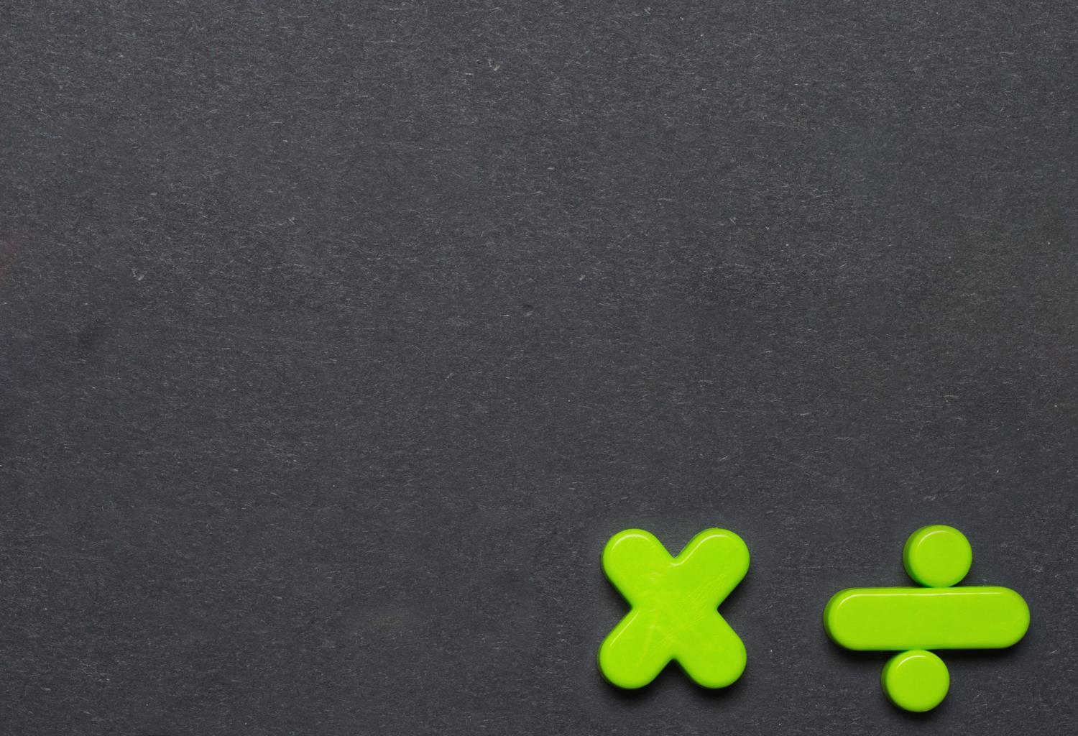


Logical shift operations
A binary shift left of one bit doubles the number
  For example: 1000=8
  Shift left once, 10000=16
A binary shift right of two places results in halving the number and rounding down each time
  Example 1: 1000=8
  Right shift once, 100 = 4
  Right shift again, 10 = 2
  Example 2: 1001 = 9
  Right shift once, 100 = 4
  Right shift again, 10 = 2

Slide 8
Shifting more than once
What effect would shifting three times have?
How would you work out the effect?
You know that one shift divides or multiplies by two.
You should remember that binary is base two, which means that each column value is a multiple of two.
Shifting is the same, each shift is another multiply by two.
For example, shifting three times would be the same as multiplying by 8.
© Pearson Education Ltd 2020. Copying permitted for purchasing institution only.
Notes:
Student Activity 3

Slide 9
Effects of logical shifts
Logical shifts can very quickly multiply or divide a binary number by a factor of two
  Left shifts multiply
  Right shifts divide
A loss of accuracy can occur if 1 bits are removed:
  22 / 4 is not exactly 5
0 | 0 | 0 | 1 | 0 | 1 | 1 | 0
0 | 0 | 0 | 0 | 0 | 1 | 0 | 1

Slide 10
Logical shifts
A logical right shift can be performed with a negative number such as -106
  What is the problem with doing this?
  The result should be half the original – e.g. -106/2 = -53
1 | 0 | 0 | 1 | 0 | 1 | 1 | 0
-106
0 | 1 | 0 | 0 | 1 | 0 | 1 | 1
75

Slide 11
Wrap up: so far you have learned how to…
Apply logical left and right shifts to binary integers.
  Shifting left one position – a new 0 is shifted in on the right (LSB).
  Shifting right one position – a new 0 is shifted in on the left (MSB).
Use logical binary shifts to multiply and divide unsigned binary integers by powers of 2.
  Each shift is another power of two.
Explain why a number may be less precise after a binary shift right has been applied
  Decimal places are lost when you divide by shifting.
© Pearson Education Ltd 2020. Copying permitted for purchasing institution only.

